Slide 1

SCHOOL OF INFORMATION TECHNOLOGY AND ENGINEERING (SITE)
DEPARTMENT OF COMPUTER APPLICATION – FALL SEMESTER
2022 - 2023
SET Project(ID - 220952)
24th January, 2023
PAPER TITLE: EVALUATION OF MACHINE LEARNING TECHNIQUES FOR PCOS PREDICTION
Guide:
Dr. ANBARASA KUMAR A
22MCA0233 - BHOOSHAN BIRJE
22MCA0321 – MANVENDRA GOSAIN

Slide 2
INTRODUCTION
Polycystic Ovary Syndrome(PCOS) is one of the most prevalent endocrine disease in women of child-bearing age. Around 12% to 21% women worldwide are affected by it.
PCOS causes the ovaries to develop small collection of fluids called follicles which make them unable to release eggs, which in turn make a women hard to conceive. Also, it increases the amount of androgen (male hormones) in the reproductive system.
Further symptoms include irregular menstrual cycles, skin infections, weight gains, high blood pressure, diabetes, anxiety and depression.
According to the survey published by European Journal of Endocrinology, PCOS patients have 51% higher risk of COVID-19 infection.
The vagueness of symptoms makes it hard to diagnose. Also, medical tests needed for diagnosis are expensive and are not available everywhere.
Therefore, this project aims to develop a machine learning diagnostic model that can predict the probability of PCOS of a patient, taking into account their medical parameters

Slide 3
LITERATURE REVIEW
Name of the paper | Findings
A. S. Prapty and T. T. Shitu, “An Efficient Decision Tree establishment and performance analysis on Polycystic Ovary Syndrome” | Dataset having 541 data points and 31 individual features for the confirmation of having PCOS. No feature engineering is done throughout the machine learning process. For pre-processing, no separate section given only conveyed that class imbalance was taken care of by splitting the dataset into a 70:30 ratio. Random forests with the accuracy of 93.5% can be concluded as the best of these classifiers based on the overall performance. Using the random forest method, a decision tree is developed.
S. Bharati, P. Poddar and M. R. Hossain Mondal, “Diagnosis of Polycystic Ovary Syndrome using Machine Learning Algorithms” | Ranked features in the training dataset according top-value and selected features accordingly. They identified the significant features to be the ratio of Follicle-stimulating hormone and Luteinizing hormone. Their results demonstrated that hybrid random forest and logistic regression on applying cross validation with 40 folds to the best 10 features demonstrated testing accuracy of 91.01% and recall of 90%
Y. A. Abu Adla, D. G. Raydan, M. Z J. Charaf, R. A. Saad, J. masreddine and M. O. Diab, “Automated Detection of Polycystic Ovary Syndrome using Machine Learning” | 541 data points, 39 features present in the dataset. To avoid biased data splitting, K-Fold Cross validation(KVC) technique implemented filtered out the features that were considered insignificant by both the doctor and the statistical test. Employed the use of filters and wrappers for features selection, performed anova test for feature significance and consulted a domain expert to make sure that the results obtained were aligned with the medical field standards Final model selected is SVM with an accuracy of 91.6%, Precision 93.665% ad Recall 80.6%

Slide 4
LITERATURE REVIEW
Name of the paper | Findings
P. Chauhan, P. Patil, N. Rane, P. Raundale and H. Kanakia, “Comparative Analysis of machine learning Algorithms for Prediction of PCOS” | Custom dataset normally distributed over various attributes of around 267 women of different groups. Feature selection based upon visualizations generated using Tableau and Google sheets. The best performance was given by Decision Tree Classifier with an accuracy of 81%. It also gave a precision of 70% and specificity of 94%.
M. S. Khan Inan, R. E. Ulfath, F. I. Alam, F. K. Bappe and R. hasan, “Improved Sampling and Feature Selection to Support Extreme Gradient Boosting For PCOS Diagnosis” | They resampled their data using a combination of ENN(Edited Nearest Neighbour) and SMOTE(Synthetic Minority Oversampling Techniques) Using ANOVA test and chi-square test, they identified 23 significant parameters to best classify PCOS. They found that the Extreme Gradient Boosting classifier(XGBoost) performed best among all other classifier with a cross-validation score of 96.03% using 10-folds.
N. Nabi, S. Islam, S. A. Khushbu and A. K. M. Masum, “Machine Learning Approach: Detecting Polycystic Ovary Syndrome & its impact on Bangladesh Women” | Custom dataset for conducting research on PCOS detection in Bangladeshi women. Collected 550 data points through a questionnaire. Used a train-test split of 80-20 and achieved 99.09% using SVM technique. XGB Classifiers and Guassian Naïve Bayes both gave 98.18% accuracy. Logistic Regression and Decision Tree both gave 97.97% accuracy. Decision Tree and Gradient Boosting Classifiers and random Forest Classifier gave same accuracy of 97.27%

Slide 5
PROPOSED WORK
The proposed system looks to solve the problem of early detection and diagnosis of PCOS. The work that has already been done in this field is significant, but the majority of it only employs a few Machine Learning models at once.
In this paper, we try evaluate most common classification models including as Decision Tree, Support Vector Classifier (SVC), Random Forest, Logistic Regression Classifier, K Nearest Neighbors, Xg-boost and Cat-boost classifier and compares them using various yardsticks to find the one which yields the greatest accuracy.
We further incorporated hyperparameter tuning for accurate accuracy of the models.
Our model uses a dataset of 541 women from 10 hospitals in Kerala. It examines trends and correlation within the medical parameters and determines the attributes which are most important in the diagnosis of PCOS.
This work targets to implement a set of prediction models using classification methods for early detection of PCOS without the need of visiting a doctor by analyzing and identifying the patterns in a patient’s medical file.

Slide 6
ALGORITHMS USED
Logistic Regression Classifier
Support Vector Classifier
Decision Tree
Random Forest
K Nearest Neighbours
XG-boost Classifier
Cat-boost Classifier

Slide 7
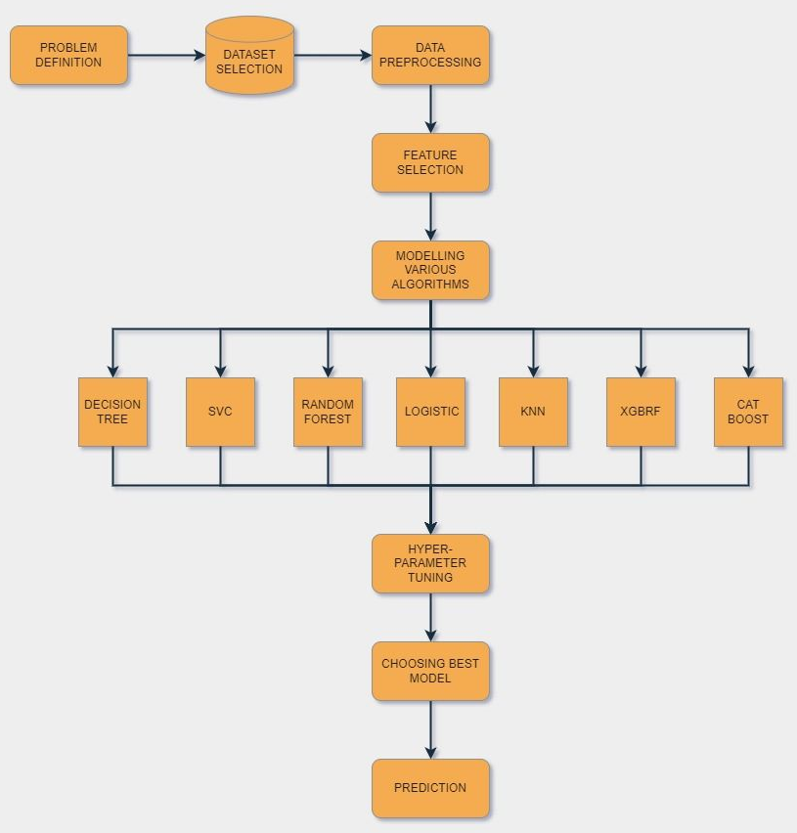
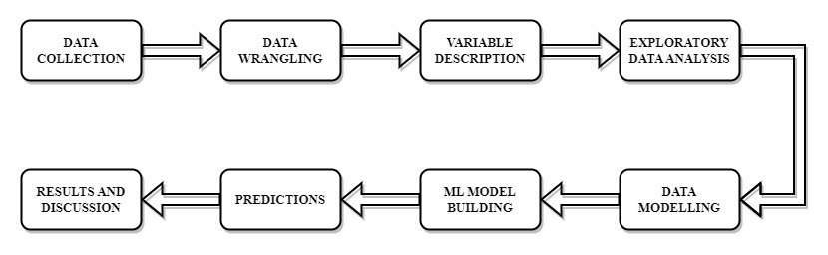
DETAILED DESIGN
DATA COLLECTION: This project uses dataset from the website Kaggle.com.
Dataset contains medical records of 541 women from 10 hospitals in Kerala.
This dataset contains all physical and clinical parameters to determine PCOS and infertility related issues. There are a total of 44 parameters.

Slide 8
DETAILED DESIGN
DATA WRANGLING:
  Dropped a column ‘Unnamed:44’ which had empty cells
  Also dropped all the duplicate columns
  Removed descriptive columns which that were not needed for processing such as “Serial No.” and “Patient file no.”
  Some columns had values encoded as objects. Standardized all of them to numeric values
  Filled the cells with null values with the median of the column values
  Removed leading and trailing spaces in column names
VARIABLE DESCRIPTION:
  The name of the variable and a brief description of what it represents
  The type of the variable (e.g., categorical, numerical, continuous, ordinal, etc.)
  The range of values that the variable can take on (e.g., for numerical variables, the minimum and maximum values; for categorical variables, the possible categories)
EXPLORATORY DATA ANALYSIS:
  Feature selection based on the correlation factor.
  Patterns of Length of The Menstrual Cycle
  Patterns of BMI
  Patterns of Irregularity in Mensuration
  Comparison of Follicle numbers

Slide 9
DETAILED DESIGN
DATA MODELLING:
  Splitting Data- Data was split into 2 groups for training and testing the models. 70% of the data was considered for training while remaining 30% for testing. Assigning 14 independent variables to X and target variable to Y.
      Training – 378 samples
      Testing – 163 samples
  Data Standardization- Standardization is a way to transform data so that it has a mean of 0 and a standard deviation of 1. This can be useful for some machine learning algorithms that assume that the input variables are centred around 0 and have a standard deviation of 1. Standardization is done using Standard Scaler function.
MODEL BUILDING: We built the models using ‘sklearn’ library in python. Metrics were calculated for all the models for further evaluation. Models used default hyperparameters for building
  Hyperparameter tuning- We have used Grid Search CV in our system. Range of values for each parameter were given. Scoring parameter for the CV was set to ‘accuracy’. Grid Search returned with the best parameter for all the models which helps the model achieve highest accuracy. After finding best parameters. Again, models were trained and tested but with their best hyperparameters

Slide 10
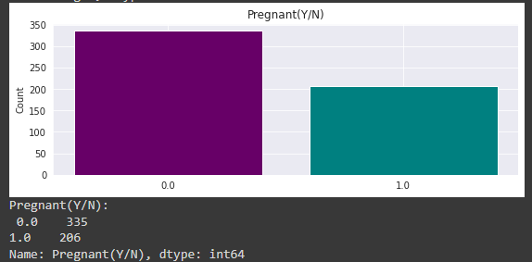
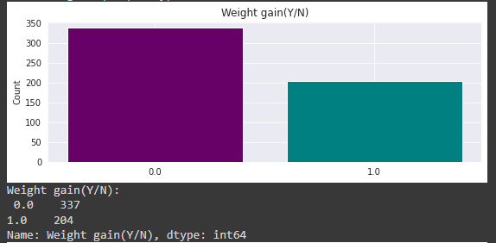
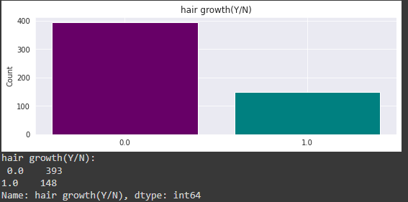
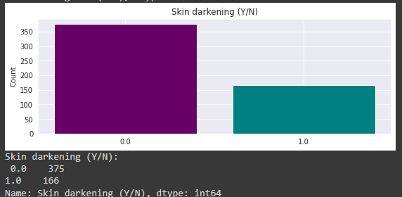
VARIABLE DESCRIPTION – CATEGORICAL VARIABLES

Slide 11
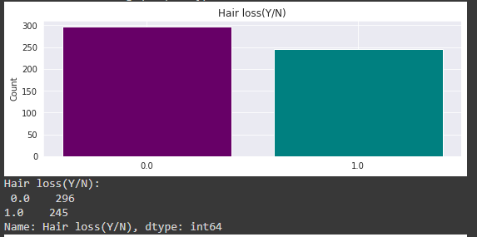
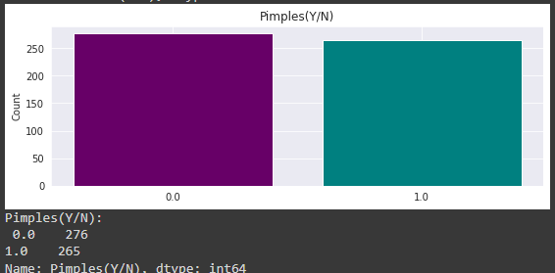
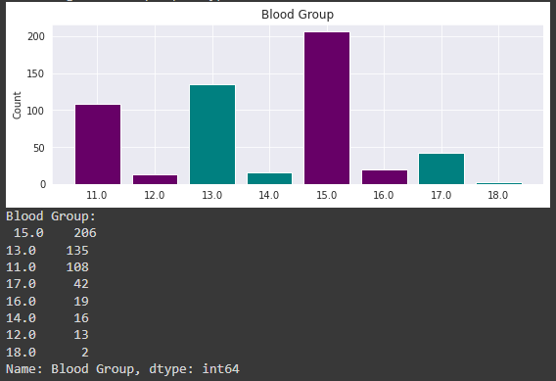
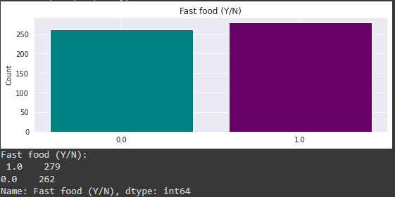
VARIABLE DESCRIPTION – CATEGORICAL VARIABLES

Slide 12
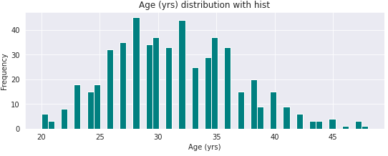
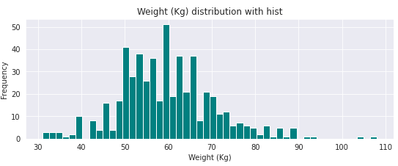
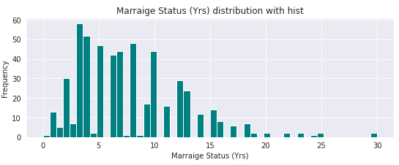
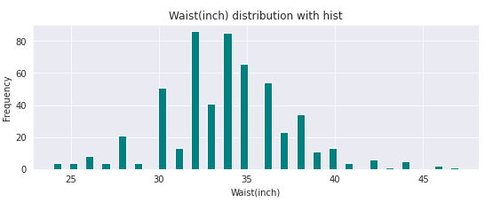
VARIABLE DESCRIPTION – NUMERICAL VARIABLES

Slide 13
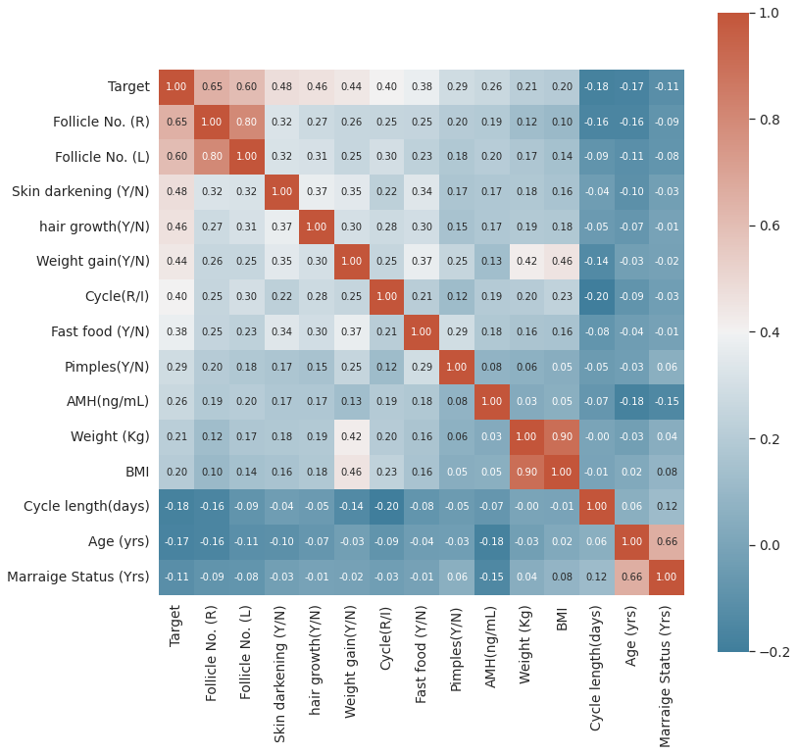
CORRELATION MATRIX – SELECTED FEATURES
Follicle No. (R) | Follicle No. (L)
Skin darkening (Y/N) | hair growth(Y/N)
Weight gain(Y/N) | Cycle(R/I)
Fast food (Y/N) | Pimples(Y/N)
AMH (ng/mL) | Weight (Kg)
BMI | Cycle length(days)
Age (years) | Marriage Status (years)

Slide 14
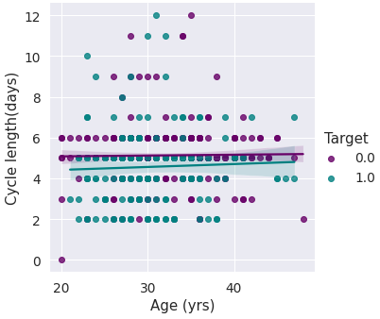
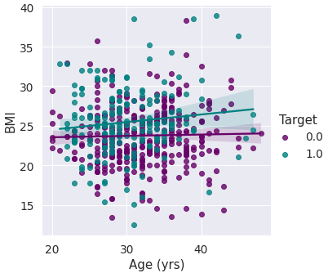
PATTERNS
Patterns of menstrual cycle length
Patterns of BMI

Slide 15
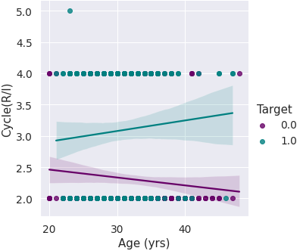
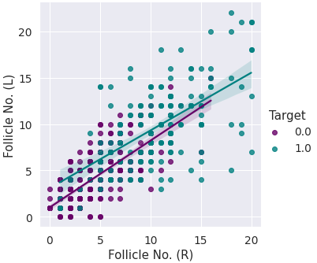
Patterns
Patterns of irregularities in menstruation
Number of Follicles

Slide 16
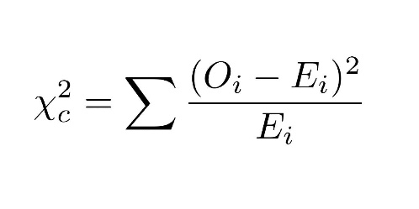
Chi-Square test
The chi-square test of independence is a statistical test used to determine if there is a significant association between two categorical variables. The test is based on the chi-square statistic, which measures the difference between the expected frequencies of the variables in the population and the observed frequencies in the sample.
where;
O is the observed frequency in each cell of the contingency table
E is the expected frequency in each cell of the contingency table

Slide 17
Chi-Square test
Chi Square Test of Independence of attributes was used to test if the categorical features considered have association with the target or not.
Null Hypothesis: Variables are independent of each other.
Alternative Hypothesis: Variables are not independent of each other.
Feature | P-Value
Skin Darkening | 5.573087703802324e-28
Hair Growth | 9.633522761918661e-27
Weight gain(kg) | 2.8716592631832225e-24
Fast Food | 4.796615760588168e-18
Pimples | 5.2977026100864164e-11
All P values come out to be less than 0.05. Therefore, we reject the Null Hypothesis.
This confirms association of Target Variables with Selected Categorical Variables

Slide 18
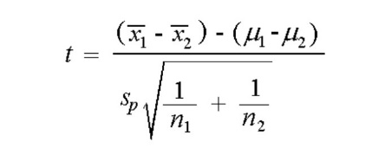
T-test
Independent Samples t-test was employed to test the influence of numerical variables namely on the target. Here, numerical variables were divided into 2 groups, variables with positive patients and variables with negative patients. Then, t-test was used to check if mean of both the groups are equal or not. If both the means(averages) are equal that means numerical variables do not affect the target variables.
Where:
x̄1 is the sample mean of group 1
x̄2 is the sample mean of group 2
s_{p} is the pooled estimate of variance
n1 is the sample size of group 1
n2 is the sample size of group 2

Slide 19
T-test
Null Hypothesis: Means of both groups are not significantly different
Alternative Hypothesis: Means of both groups are significantly different.
Feature | P-Value
Follicle No. (R) | 7.956425231675759e-66
Follicle No. (L) | 6.036529826024768e-55
Cycle(R/I) | 2.1754276134108946e-22
AMH(ng/mL) | 4.355535073050478e-10
Weight (Kg) | 6.532451436302058e-07
BMI | 2.904846132334269e-06
Cycle length(days) | 2.9758227373105653e-05
Age (yrs) | 8.194488228196828e-05
Marriage Status (Yrs) | 0.008489122480446535
All P values come out to be less than 0.05. Therefore, we reject the Null Hypothesis.
This confirms effect of numerical variables on Target Variable.

Slide 20
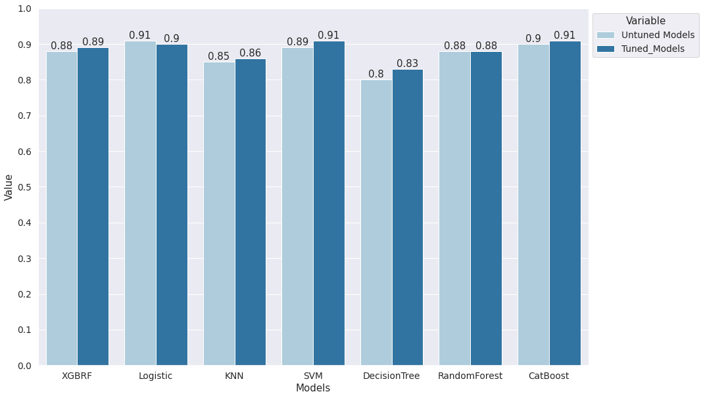
Accuracies – Tuned Vs. Untuned

Slide 21
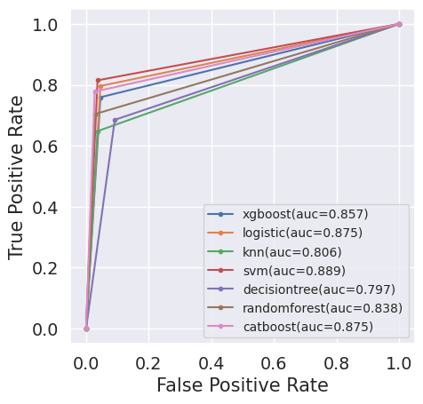
AUC-ROC Curves
AUC-ROC curve is a performance measurement for the classification problems.
The ROC curve is plotted with True Positive Rate against the False Positive Rate where TPR is on the y-axis and FPR is on the x-axis.
ROC is a probability curve and AUC represents the area under ROC curve.
It tells how much the model is capable of distinguishing between classes. Higher the AUC, the better the model is at predicting 0 classes as 0 and 1 classes as 1.

Slide 22
Testing RESULT
Models | Accuracy | Precision | Sensitivity | Specificity | F1-Score | AUC
SVM | 0.91 | 0.81 | 0.81 | 0.96 | 0.86 | 0.89
Cat Boost | 0.91 | 0.78 | 0.78 | 0.97 | 0.85 | 0.88
Logistic | 0.90 | 0.80 | 0.80 | 0.95 | 0.84 | 0.88
XGBRF | 0.89 | 0.76 | 0.76 | 0.95 | 0.82 | 0.86
Random Forest | 0.88 | 0.70 | 0.70 | 0.97 | 0.80 | 0.84
KNN | 0.86 | 0.65 | 0.65 | 0.96 | 0.75 | 0.81
Decision Tree | 0.83 | 0.69 | 0.69 | 0.91 | 0.73 | 0.80
Accuracy and Sensitivity are used as important metrics for this study. This is because, we hope to achieve highest possible accuracy for our prediction model. Higher the accuracy, greater the chances of accurate predictions. Moreover, in medical inspections, it is intended to miss as few positive cases as possible and higher the sensitivity values, lower the chances of positive cases missed.

Slide 23
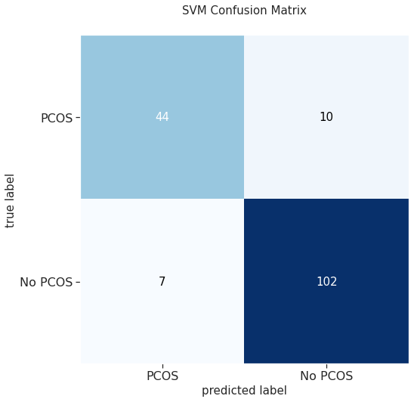
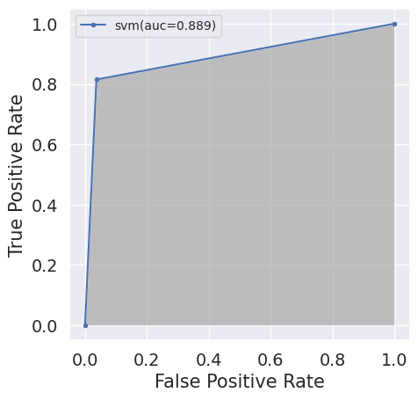
RESULT
SVM performs better than all the other models for our system with an accuracy of 91% and a sensitivity of 81%
Confusion matrix gives the following inferences:
True Positive: SVM predicted 44 PCOS patients who actually had it.
False Positive: SVM predicted 10 patients to have PCOS, but they did not.
False Negative: 7 patients were predicted not to have PCOS by SVM, but they actually had it.
True Negative: SVM predicted 102 patients to be unaffected by PCOS who were in fact unaffected.

Slide 24
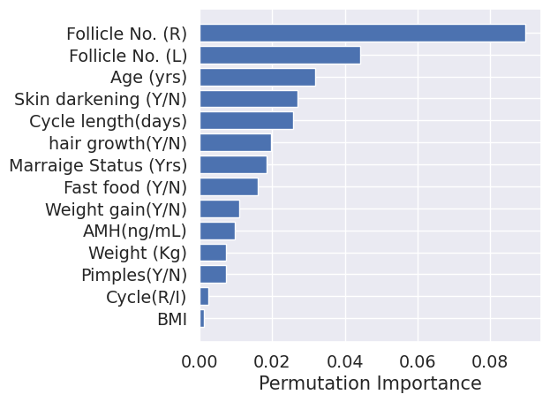
Feature Importance
For a given model, feature importance refers to the method of calculating a score that represents the importance of each input feature. If a feature has a high score, it has a greater impact on the model that is being used to predict a certain variable.
Plotting Permutation importance graph, we get the top 4 features which SVM found most influential in prediction of PCOS are
Follicle No. (R)
Follicle No. (L)
Age (yrs.)
Skin darkening (Y/N)
From the tuned SVM we can still get false results in that case to avoid misleading results, we can take the help of feature importance from which we will see the 4 most important features and compare them with the ideal parameters and if they are violating it, we can tell the patient that he/she is at the risk of having PCOS.

Slide 25
Conclusion & Future Work
Today, millions of patients are affected by PCOS but the tragedy is that most of them are unaware of it. Patients suffer significant health consequences as a result. Our main goal was to develop a system that would allow a patient to determine their risk of PCOS by entering a few basic health information.
In this study, we explored various medical parameters, how they are related to each other and how they vary for a person with PCOS. Then we explored various machine learning models. Tuned their hyperparameters to get accurate results. Out of all, SVM performed better than others with an accuracy of 0.91 and Sensitivity of 0.81.
Further, Number of follicles in both the ovaries, Age and darkening of skin came out to be the most important features for the diagnosis of PCOS. Due to imperfection of the model, along with the system prediction, above four features should be compared with ideal values for the diagnosis.
The dataset used for investigation had a smaller number of samples and it was concentrated on a single geographical location. For improving the diagnosis model large number of datasets have to be collected and awareness about PCOS should be increased.

Slide 26
THANK YOU

